Slide 1
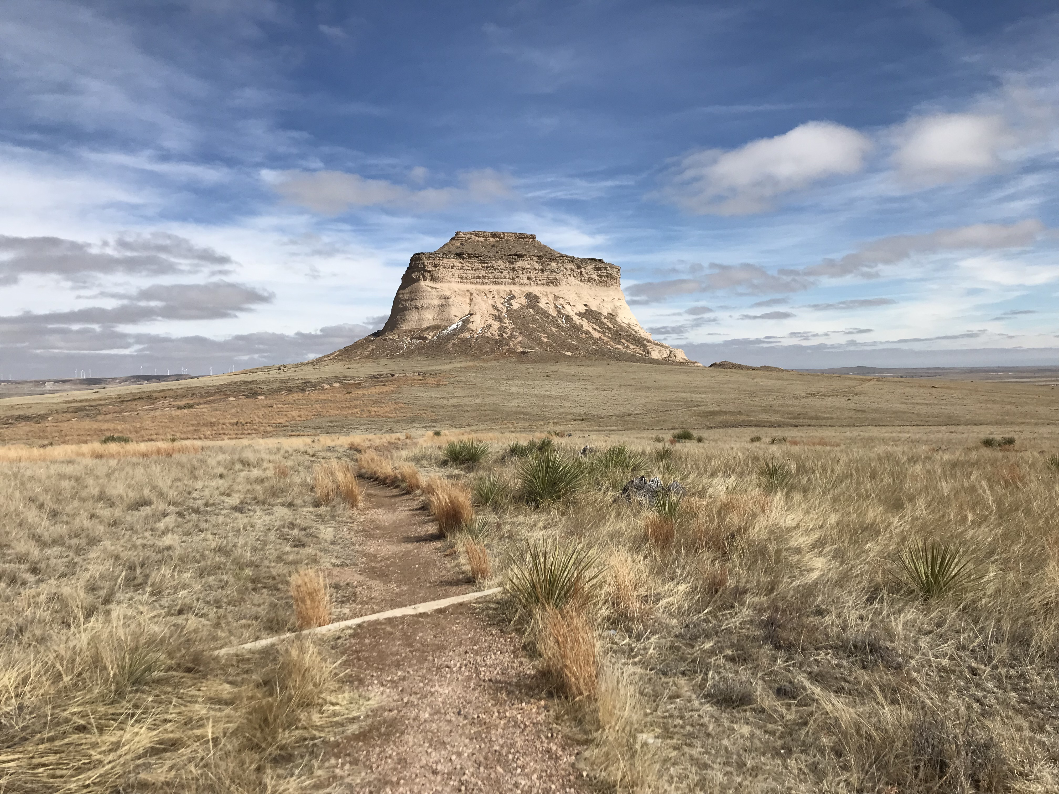
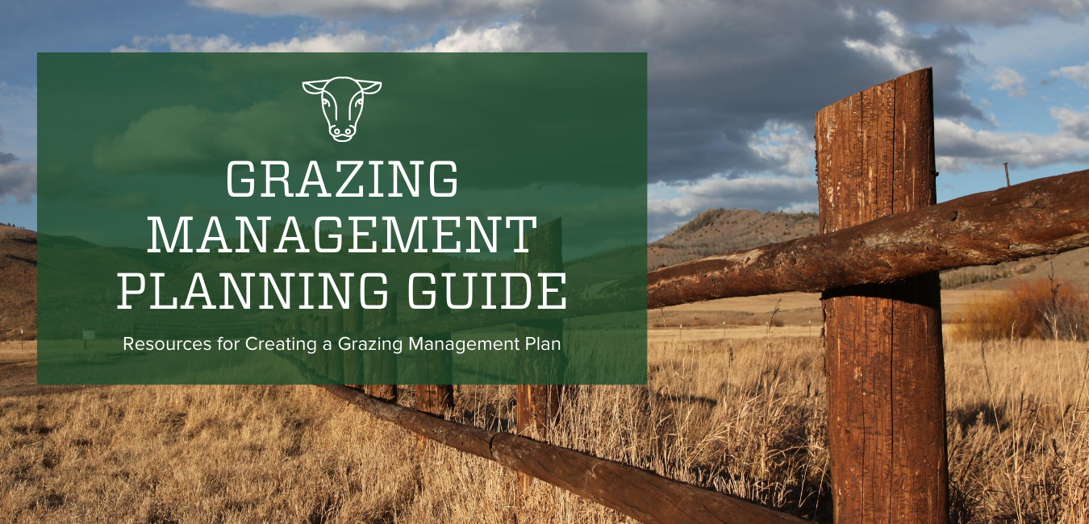
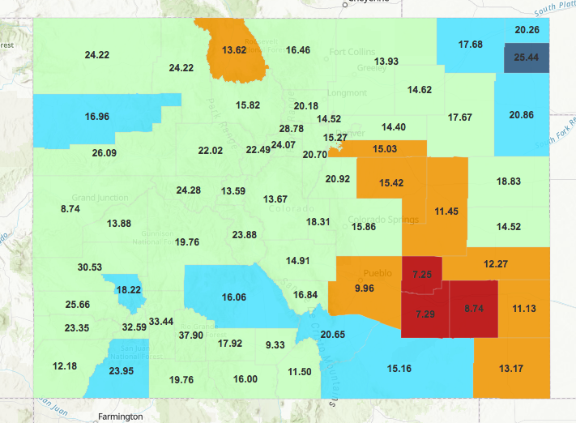
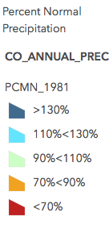
Designing Effective Education Materials for Range Management and Soil Health Fort Collins, CO
Advisors:
Kevin Jablonski, Extension Research Coordinator Retta Bruegger, Regional Extension Specialist
Annie Overlin, Regional Extension Specialist
Katherine Denune
PROJECT INTRODUCTION AND GOALS
WHAT I DID
WHAT I LEARNED
CSU Extension Specialists identified the need for new and effective peer reviewed education materials to further assist ranchers and range managers. My internship focused on addressing this need by assisting in the development of a variety of online informative guides, videos and social media posts.
With the challenges of COVID-19 changing summer plans, I worked with my mentors to adapt my internship to work remotely. Unable to do the originally planned field component, I jumped right in to my online setting and started working on developing new and accessible education materials.
The goals of my internship were to assist in the creation of communication and education materials to deliver relevant science to ranchers and range managers.
During my 10 week internship, I:
Created a resource guide on the Extension webpage for Developing a Grazing Management Plan. This involved reviewing and selecting the best resources from state Extension programs and government agencies.
Developed content for and helped promote the Rangelands Colorado Facebook page. We started on April 29th and as of early September our reach is over 60,000 and we have gone from 1 to over 600 “friends”. Posts are organized by monthly themes such as preparing for drought, wildfire, supplement and range forage, etc.
Constructed an ArcGIS map of Colorado historical precipitation from 1981-2018. I am currently working on finalizing the ArcGIS Dashboard for this project to increase the accessibility of the precipitation data.
Completed a comprehensive literature review on grazing and soil health for an upcoming fact sheet.
Edited and closed captioned an informational video on static pile high fungal compost featuring Dr. David Johnson and Alamosa County.
Prepared mineral and biological soil tests and plant tissue tests for the upcoming workshop on regenerating soil health with Nicole Masters.
I had the opportunity to learn more about rangeland management and gain timely skills in social media and ArcGIS.
Specifically I learned:
How to develop a grazing management plan
The importance of soil microbiology, soil crusts and composting
How to develop, plan and implement a social media campaign
Basic skills in ArcGIS Pro, ArcGIS Online and ArcGIS Dashboard
How to use WordPress and Canva (a graphic design platform) to create and edit webpages
Extension video captioning and preparation for distribution
Figure 2. Webpage and Social Media Designs
A.
B.
Figure 1. ArcGIS Historical Precipitation Project
Exploring Pawnee National Grassland before COVID-19.
CONNECTIONS TO MY EDUCATION
Figure 2. (A) A webpage slider advertising the new grazing management planning guide webpage. (B) A social media post to accompany education materials on the Rangelands Colorado Facebook page. I created these images using a graphic design platform called Canva and these images are representative of additional social media designs I created during my internship.
This fall is my second semester of my Masters in Natural Resources Stewardship with a specialization in rangeland ecology and management. I am so happy to have had this internship as the focus on rangeland management and soil health directly relates to my studies and what I am passionate about.
Beyond learning more about range management, I feel lucky to have made personal connections with my mentors. My advisors have already been very helpful in providing me with experience and insight into their work as Regional Extension Specialists and Coordinators.
NEXT STEPS
This fall I am excited to be able to continue my work part-time with CSU Extension. I am currently working on finishing the Colorado historical precipitation Dashboard and assisting with preparations for the upcoming soil health workshop.
This internship has been a fantastic experience and I am looking forward to pursuing further opportunities to work with Extension programs and Colorado rangelands in the near future.
Figure 1. A screenshot of the ArcGIS Dashboard of the Colorado historical precipitation project from 1981 to 2018. This image displays precipitation data from 1981. The legend describes how the data is grouped (colored) according to percent of normal precipitation. In addition, the total precipitation (inches) for 1981 is given for each county.
Summer 2020
Warner College of Natural Resources

