Slide 1
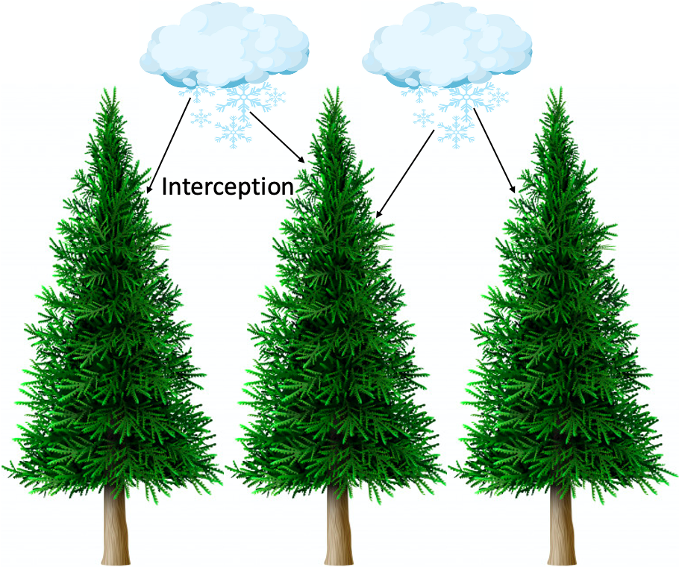
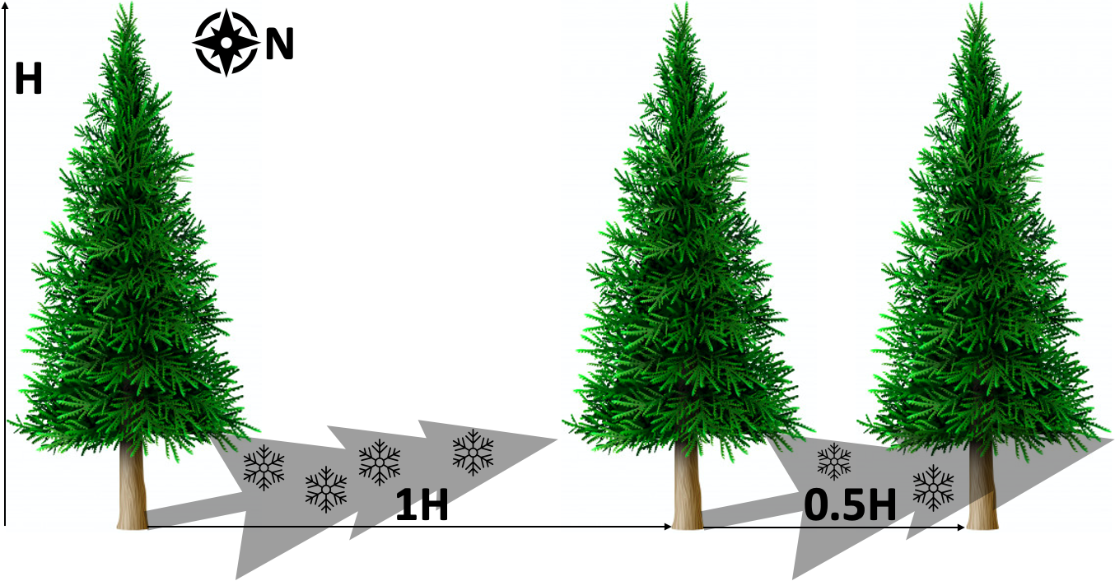
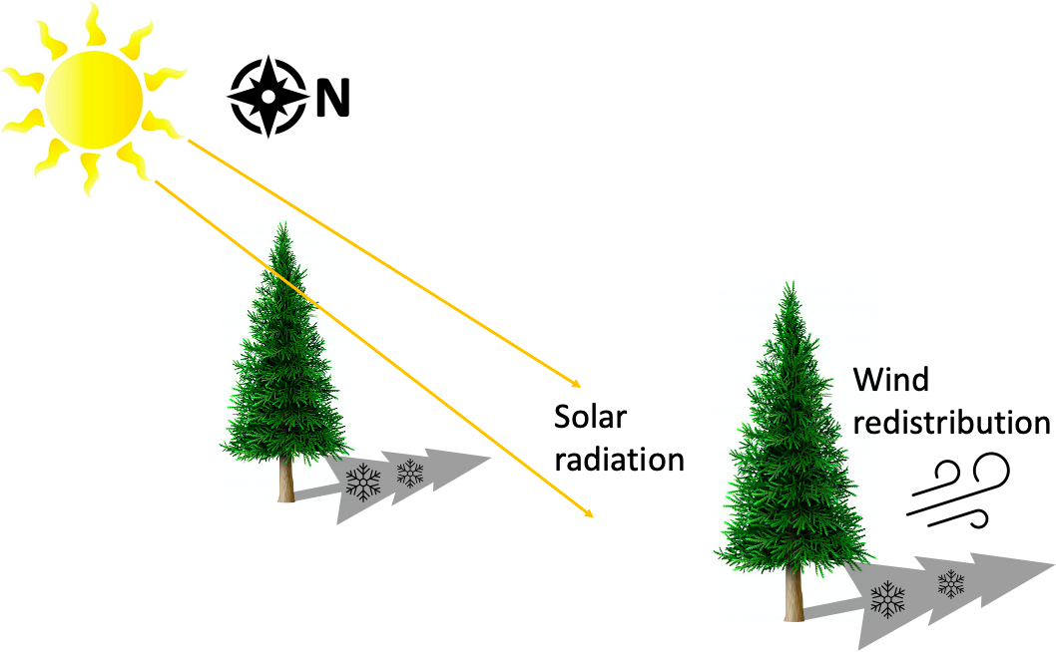
Forest management activities to increase water yield in Colorado
Intern:
Kristin Leger
Extension Internship Team:
John Sanderson, CSU Center for Collaborative Conservation Director
Rob Addington, TNC Colorado Forest Program Director
Kerri Rollins, CSU Extension Larimer County Director
Mark Platten, CSU Extension Teller County Director
PROJECT INTRODUCTION
WHAT YOU DID
WHAT YOU LEARNED
Colorado is expected to face severe water shortages as a result of population growth and climate change (CWCB, 2018). According to the Colorado Water Conservation Board, the state’s population will double to 9 million by 2050. To compound this, climate change is causing drought, increased frequency and severity of disturbances events, and hydrological changes including altered precipitation patterns and less snowpack (MacDonald & Stednick, 2003). Certain forest management activities have the potential to increase water yield by maximizing snow accumulation, retention, and streamflow. The reduction of canopy cover via mechanical thinning and prescribed fire subsequently reduces snow interception rates—allowing more snow to accumulate on the forest floor (Golding & Swanson, 1986). On the other hand, complete canopy removal via clearcutting creates large, open areas that increase snow’s exposure to solar radiation and wind redistribution—ultimately leading to more ablation and higher snowmelt rates (see Figure 2; Golding & Swanson, 1978). There is a need to identify an optimal level of forest canopy cover that can simultaneously maximize snow accumulation and minimize snowmelt rate. To address this need, a rapid systematic literature review was conducted to examine how forests can be managed to influence snow processes (i.e., snow accumulation, retention, snowmelt, and streamflow).
I partnered with Rob Addington from The Nature Conservancy, Colorado to address the conservation challenge of anticipated water shortages throughout the state. Together with Rob and my Extension Internship team, we formulated the following research question:
How can forests be managed to influence snow processes in Colorado?
With the support and guidance of my Extension Internship Team, I conducted a rapid systematic literature review to answer the research question. A total of 40 papers published between 2000-2020 were included in the review. The results were used to make management recommendations to increase water yield in response to projected water shortages from population growth and climate change.
The following management recommendations were formulated based on the literature:
Mechanical thinning to reduce canopy cover is the most effective way to increase water yield.
Forests in Colorado should be thinned to remove 20-75% of canopy cover throughout the watershed, depending on aspect and elevation.
Treatments such as strip-shelterwood and gap-thinning that retain trees throughout the watershed have the most potential to increase water yield, as opposed to removing 100% of canopy cover via clearcutting.
Gap-thinning treatments should be implemented to create many small gaps throughout a watershed (optimal gap size 0.5-2H, H=average height of surrounding trees, see Figure 3).
Mechanical thinning on north-facing slopes is the best way to simultaneously maximize snow accumulation and minimize snowmelt rate.
Mechanical thinning should be concentrated in high elevation forests, as these efforts have the greatest potential to increase water yield.
Forests that are a mosaic of aspen intermixed with conifers have the potential to increase water yield.
Figures 1-3: Snow accumulation with various levels of canopy cover.
Figure 1 (left): 100% canopy cover causes high snow interception rates and prevents snow from accumulating on the forest floor as snowpack.
INTERNSHIP GOALS
Compile results from both empirical and model-based studies that look at the impacts of canopy removal on snow processes.
Use these results to provide practical management recommendations to forest managers in Colorado for how they can manage forests to increase snow accumulation and water yield.
Figure 3 (right): Removing 20-75% of canopy cover to create gap sizes 0.5-2H simultaneously maximizes snow accumulation and minimizes snowmelt rate.
HOW DOES THIS APPLY TO YOUR EDUCATION
I am currently pursuing my Master’s degree in Conservation Leadership at CSU. As part of this graduate program, we have been trained to approach complex conservation challenges from a social-ecological lens, because environmental issues cannot be separated from humans. In the case of my project, there is the social component of water use by stakeholders including agriculturalists, municipalities, utilities companies, and industry. The ecological component is forest health and structure. This internship has provided me with valuable information that will ultimately help me work toward my future career goal of managing forests and water resources in Colorado.
NEXT STEPS
Figure 2 (right): 100% canopy removal via clearcutting exposes snow in openings to solar radiation and wind redistribution, causing high ablation and snowmelt rates.
I wrote a comprehensive technical report based on the results of the literature review. I have submitted this report to my Extension Internship Team and am currently awaiting their feedback. Once I receive feedback, Rob Addington and I will work together to create an Executive Summary of the report that can be used by The Nature Conservancy to help inform forest management decisions in CO.
References: 1. Golding, D. L., & Swanson, R. H. (1978). Snow accumulation and melt in small forest openings in Alberta. Canadian Journal of Forest Research, 8(4), 380–388. 2. Golding, Douglas L., & Swanson, R. H. (1986). Snow distribution patterns in clearings and adjacent forest. Water Resources Research, 22(13), 1931–1940. 3. Home | DNR CWCB. (2020). Retrieved September 26, 2020, from https://cwcb.Colorado.gov/. 4. MacDonald, L. H., & Stednick, J. D. (2003). Forests and water: A state-of-the-art review for Colorado. CWRRI Completion Report No. 196. Fort Collins, CO: Colorado State University. 65 p. https://www.fs.usda.gov/treesearch/pubs/59257
Colorado State University

