Slide 1
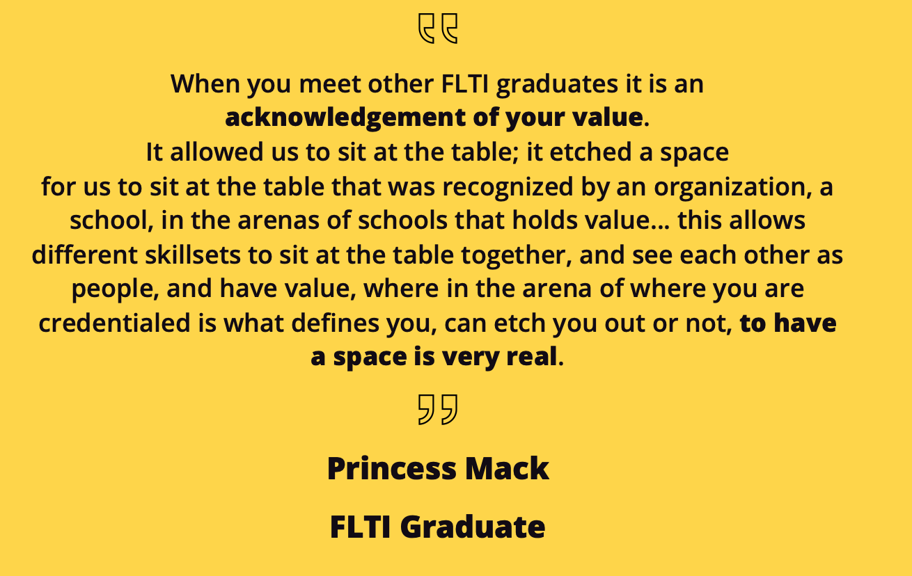
FLTI of Colorado CSU Extension
Virginia Smith
Patti Schmitt, Director
David McPhee, PhD
PROJECT INTRODUCTION
WHAT YOU DID
WHAT YOU LEARNED
The interconnected nature of content vs context experts, and the importance for community engagement efforts that all experiences and expertise are honored, and those in marginalized populations are sought-after and have an equitable seat and voice.
A better understanding of the barriers to equitable civic engagement in public and private spaces. The first-hand experience working with FLTI administration and leadership teams granted me an understanding of the the preparation that has to take place in order to ensure that the tools of democracy are available to whole communities.
A more thorough understanding of the nuances of the language that exists in the quest towards social justice
Facilitation skills in community spaces; the skills of being able to navigate a space not as a teacher or content expert but rather as someone there to support and help guide the work of the group as they create, develop and come to understandings in conversation.
How to engage communities when there are unforeseen or catastrophic events, such as pandemics, that can affect community engagement.
How an effective organization follows the core social work tenants of engagement, assessment, intervention, and evaluation.
The Family Leadership Training Institute CSU Extension is working to develop a tool that will allow communities and stakeholders to assess where they can better leverage resources to increase their capacity for community-driven change. This effort involves a national panel of experts and practitioners.
FLTI CSU Extension’s foundational theory is that when the tools of democracy are accessible and understood, leaders from all walks of life will engage in civic activities, strengthening the social fabric of our communities.
FLTI CSU Extension administrative team works diligently to ensure that programs and additional offerings are in line with current research. The Civic Capacity Index is already being sought-after by communities and organizations that trust the FLTI CSU Extension team to consistently deliver tools and resources to further engagement missions.
Work done through this internship was intended to allow the Civic Capacity Team to use the concept mapping process to identify key features in community-driven change; these key elements serving as the basis for the Civic Capacity Index.
Engaged in readings of research supporting and analyzing civic engagement.
Successfully completed IRB training to ensure that contributions to FLTI research were ethically and scientifically valid
Supported staff in the creation and implementation of the first Civic Learning Lab workshop: A workshop designed to assist community and family leaders as they plan, navigate, and hold difficult conversations in their communities.
Completed interviews of FLTI graduates on the topic of their journey with the FLTI curriculum and their experiences after graduation from the program.
Completed results mapping interview coding for FLTI graduate interviews.
Participated in FLTI team meetings in order to understand the collaborative nature that makes FLTI Colorado Extension successful.
Work as an active listener in community spaces and leadership team meetings to further deepen my understanding on social justice, and how to build community trust.
ENGAGING COMMUNITIES
INTERNSHIP GOALS
To serve and support FLTI’s mission and vision through both indirect and direct means.
Expand on my social work knowledge of engaging diverse communities
Observe, listen and learn from experts in the field of community engagement in a variety of systems.
To understand and witness how change happens at the micro, mezzo and macro systems levels
Support research efforts to develop a tool for communities and groups to assess their civic capacity for community-driven change.
HOW DOES THIS APPLY TO YOUR EDUCATION
GRADUATE QUOTE
NEXT STEPS
FLTI’s focus on providing the tools and skills necessary for individuals and communities to work towards meaningful change directly relates to my educational focus as a student of social work.
FLTI encompasses the micro, mezzo and macro systems that are foundational to social work and the understanding of the intersectionality of individuals and communities.
The research that FLTI engages in is providing a better understanding of change agents, while also working to provide communities with tools that will allow them to engage their communities in more effective manners than ever before.
FLTI’s emphasis on growing community leaders as experts and facilitators in the program and their communities is a practical application of the social work values of social justice, dignity and worth of a person, and value of human relationships
I am interested in pursuing a Masters of Social Work degree through an accredited advanced standing program.
Post graduation I hope to engage in macro level social work with an emphasis on research-based practices.
FLTI next steps include continuing to validate the Civic Capacity Index and use it to guide community planning and actions.
COLLEGE OF HEALTH AND HUMAN SCIENCES

