Slide 1
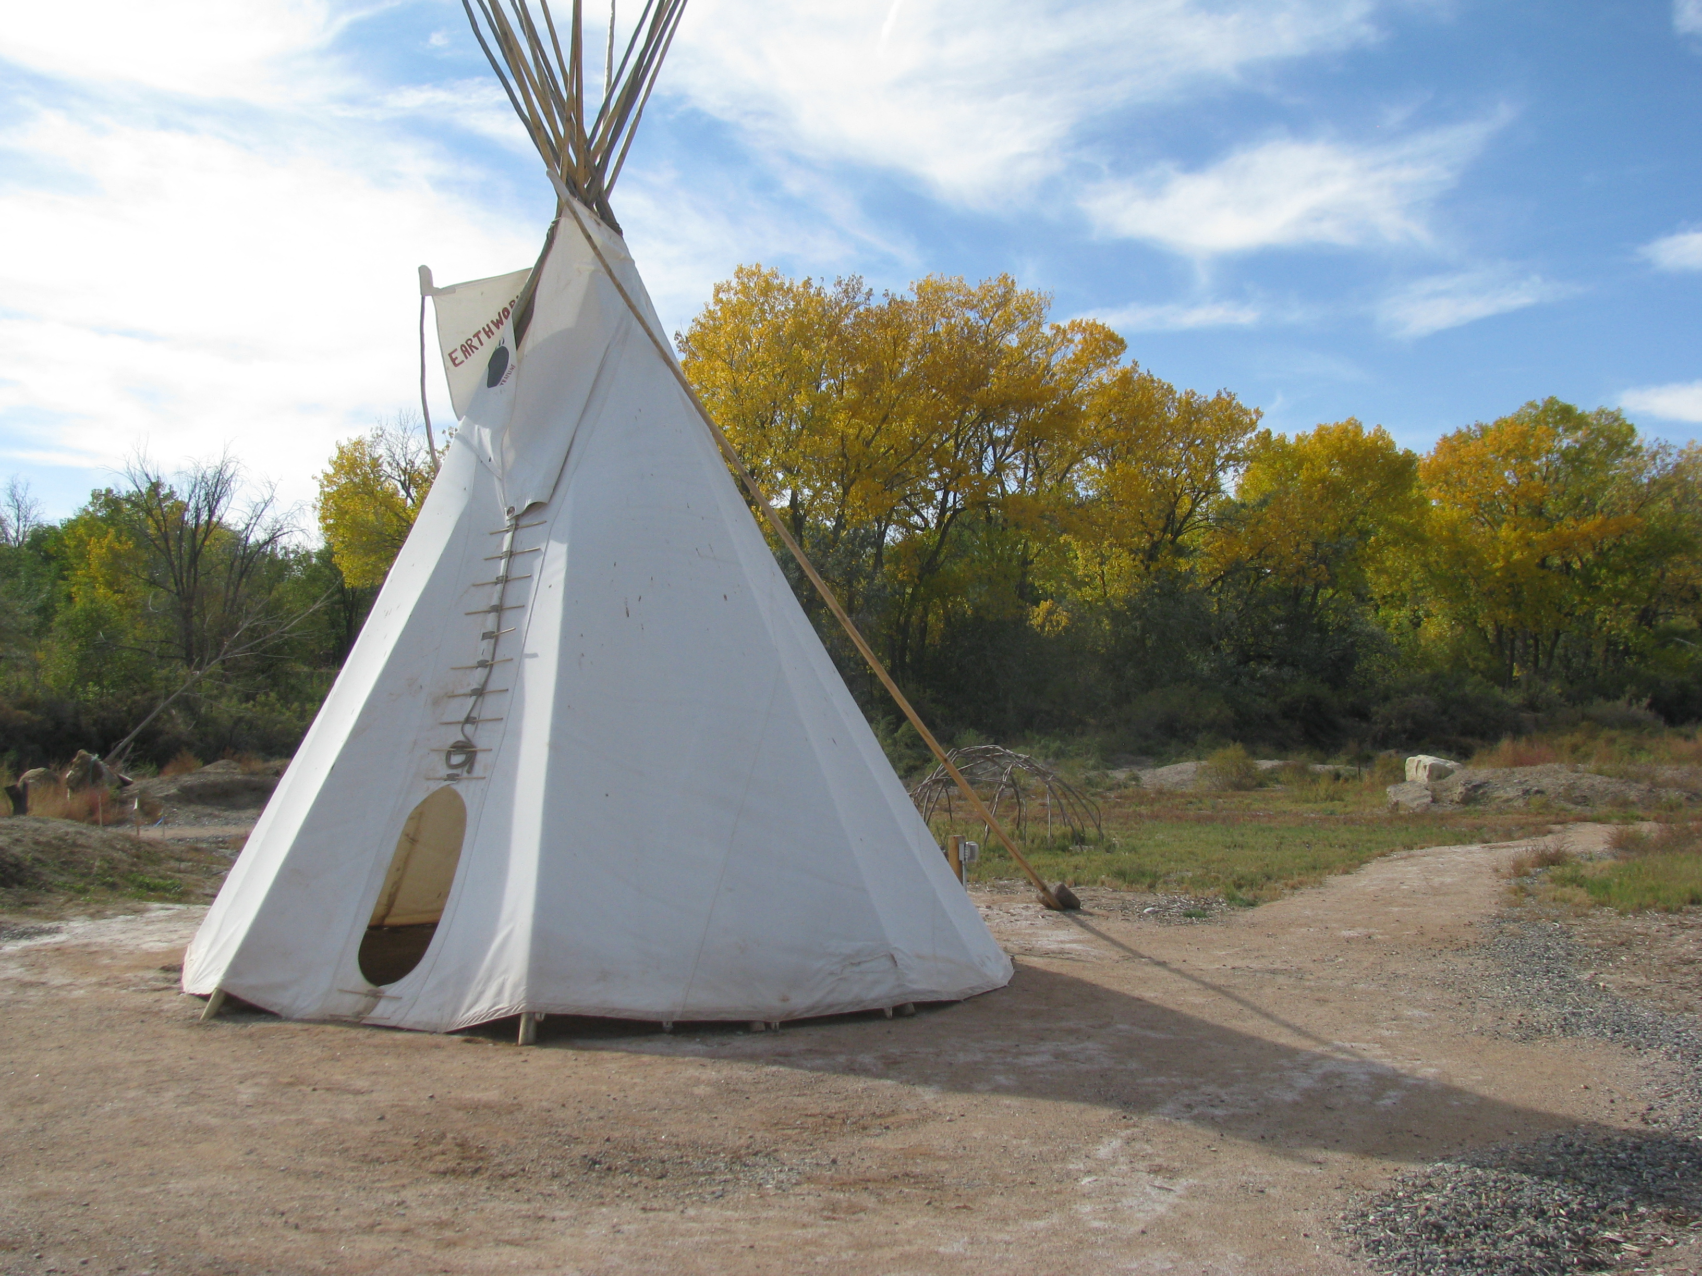
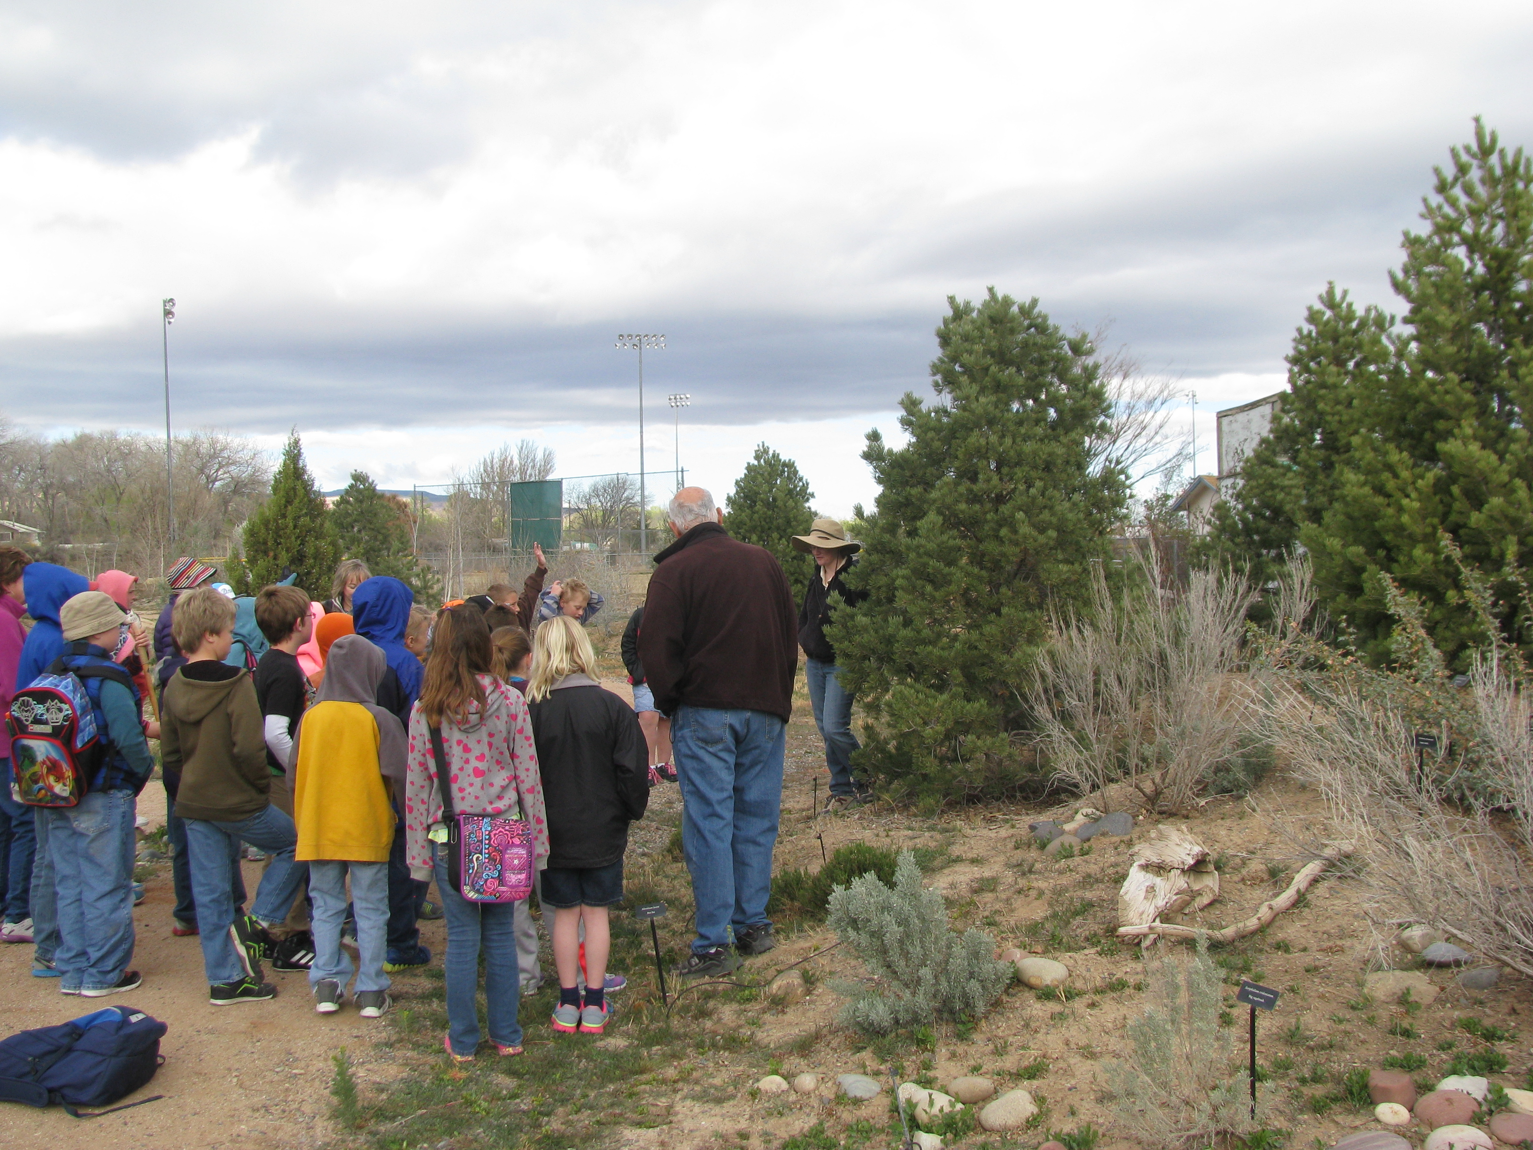
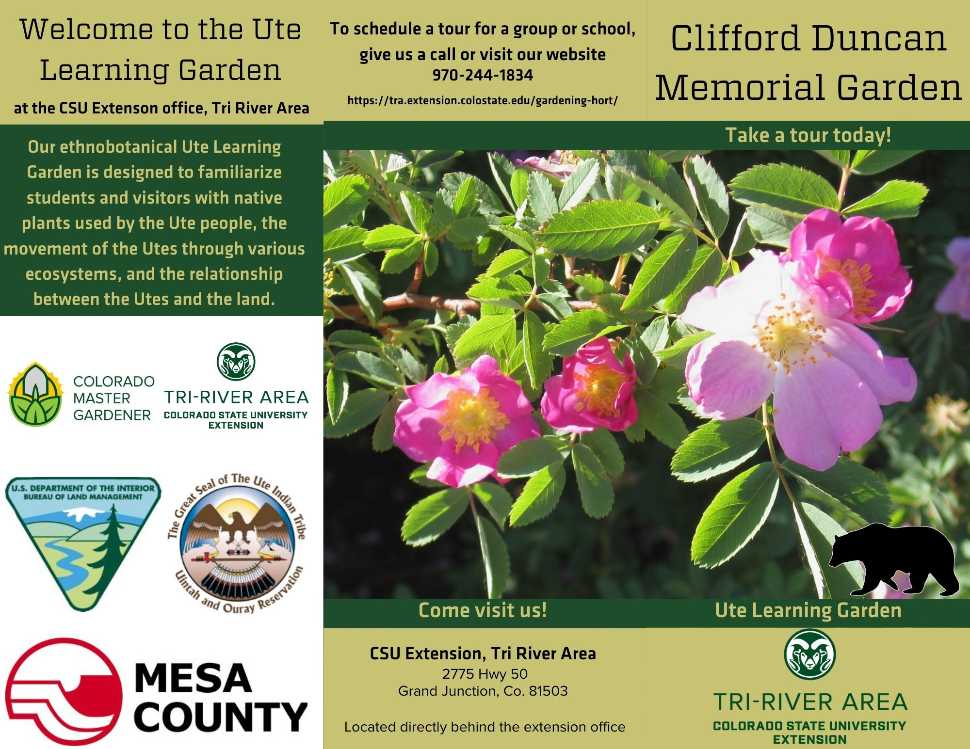
Ute Learning Garden Grand Junction, Mesa County
Anthony Bellucci
Susan Carter – CSUE Tri River Area Horticulture and Natural Resource Agent.
Dr. Doreen Martinez – Associate professor, CSU.
PROJECT INTRODUCTION
COMPLETED OBJECTIVES
TAKEAWAYS
The Ute Learning Garden emerged in 2008 as part of a larger project to understand and preserve the ethnobotanical wisdom of the native Ute Tribes. Ethnobotany is defined as the scientific study of the traditional knowledge and customs of a people concerning plants and their medical, religious, and other uses.
Throughout the last decade, Susan Carter and various volunteers have worked with the Bureau of Land Management and the Utes of the Uintah and Ouray reservation to create a garden which reflects the cyclical and seasonal nature of Ute living as well as demonstrates the various plants used by the Utes throughout the year.
The purpose of this garden is not only to preserve ethnobotanical wisdom but also educate Western Slope populations about the plants that surround them and the people that preceded them, The garden also functions as a place for the Utes to come visit with plants and information that may have been lost over generations of orally passed traditions.
In order to reach our two primary goals, Susan and I laid out, and completed, a large number of projects over the summer.
I spent a large amount of time in the garden weeding, trimming, planting, and doing general maintenance to make the garden look more presentable. Throughout my garden work, I logged the plants we had and their locations within the garden. Working with a master gardener volunteer, I helped develop a new map for the garden. This map will help the extension office track plant growth and losses as well as help visitors navigate the garden with greater ease.
After documenting the plants we had in the garden, I researched available resources, especially those pertaining to the Utes, to find ethnobotanical uses of the various plants. These uses were logged and compiled in an easily accessible way. I then used this information to design plant labels which will be placed in the garden. Each label will contain both the plant name and an ethnobotanical use if one was available.
While compiling this information, we decided to redesign the garden tour to focus on the various life zones found in the western slope. To accomplish this, we did several things. The first was a complete redesign of the tour book used by our docents. The updated tour book takes visitors on a journey through various elevations and life zones giving the visitor a feel for the seasonal lifestyle of the Utes. Second, I designed several informational signs to aid self guided tours which explained the various life zones and various principals of the Utes lifestyle. Finally, I created several informational posters to be hung in the Extension office as a precursor to the garden.
One of the major hurdles in visitation was poor advertising materials. To address this, I redesigned the brochure (seen below) and worked with a web developer to make our website easier to navigate, more accessible, and more informative. Throughout this entire process, we checked in with our Ute contact, Betsy Chapoose, to assure the information we put forward was accurate and represented an appropriate image of the Utes.
This experience was an immeasurable learning opportunity for me. Not only did I get to hone my marketing, gardening, and research skills but I was also given an intimate look into Extension offices, native plant communities, and the history of Colorado and its people.
Through various research and projects, I learned how bigger organizations communicate and interact to achieve large goals that encompass many people. We had to be in touch with entities like BLM and the Utes as well as smaller organizations like the Ute museum of Montrose, Colorado, to achieve the lofty goals we set for ourselves at the beginning of the internship. These interactions taught me a lot about organizational communication and goal setting.
Learning about the Utes history in Colorado and their wisdom of our native plant species was a humbling experience. They achieved so much before the advent of information access and their knowledge of this land is still applicable. The information they’ve shared on various plants and plant communities in Colorado has brought my closer to my state in many ways.
Our desire to increase visitation taught me a lot about branding, building community interest, and constructing a cohesive and meaningful experience. Through a variety of projects, I developed important communication skills that will aid me in developing visitation strategies for potential employers.
INTERNSHIP GOALS
There were two main goals going into the internship. The first was to increase visitation and community involvement with the garden. This included garden maintenance, a redesign of the garden tour, and media production.
The second goal was to increase the amount and accuracy of information we had about both the Utes and the plants we had on the property. This involved plenty of research as well as communication with both BLM and the Ute Tribe.
EDUCATIONAL APPLICATIONS
NEXT STEPS
As a horticulture therapy student, this internship offered me an opportunity to strengthen many of the skills used in the day to day world of horticulture. We did a good bit of garden work as well as brand development for our garden; an important skill to bring visitors to a site. I learned a lot about daily care of a garden including pruning, weeding, drip line upkeep, and planting.
One of my favorite results is that I developed a great knowledge of plants that grow in Colorado and the ways in which people could use them. This will be an essential skill working for any garden in Colorado.
With the current pandemic, it was almost impossible to see if any of our work had paid off as the garden was still not open for tours. When the world begins to normalize, we need to distribute our brochures to the community and ensure our website is easily found through google search. Contact with various schools to arrange tours would also be a good litmus test for the tour we designed. Arranging community events at the garden, including dinners and tours, would also help bring people in. These events would familiarize local populations with the plants in our garden and help them better connect with the native plant communities around them. I feel as though this is just the beginning for the Ute garden and it could soon become a staple of the Grand Junction community.
Colorado State University

